Slide 1
Stock Market Prediction System

Slide 2
What is Stock Market Prediction?
Stock market prediction refers to the process of forecasting future movements in stock prices, market trends, and investment opportunities based on historical data, market analysis, and predictive modeling techniques.
It involves using various statistical, mathematical, and machine learning algorithms to analyze past market data, identify patterns, and make informed predictions about future market behavior.
Stock market prediction aims to help investors and traders make better investment decisions by providing insights into potential price movements, volatility, and risk levels in the market.
While stock market prediction can never guarantee accurate results due to the inherent uncertainty and complexity of financial markets, it serves as a valuable tool for investors to mitigate risks and optimize their investment strategies.

Slide 3
Data Sources
Sources of data for stock market prediction
Examples: historical stock prices, company financials, economic indicators, news sentiment, etc
The yfinance is one of the famous modules in Python, which is used to collect online data, and with it, we can collect the financial data of Yahoo. With the help of the yfinance module, we retrieve and collect the company's financial information (such as financial ratios, etc.)

Slide 4
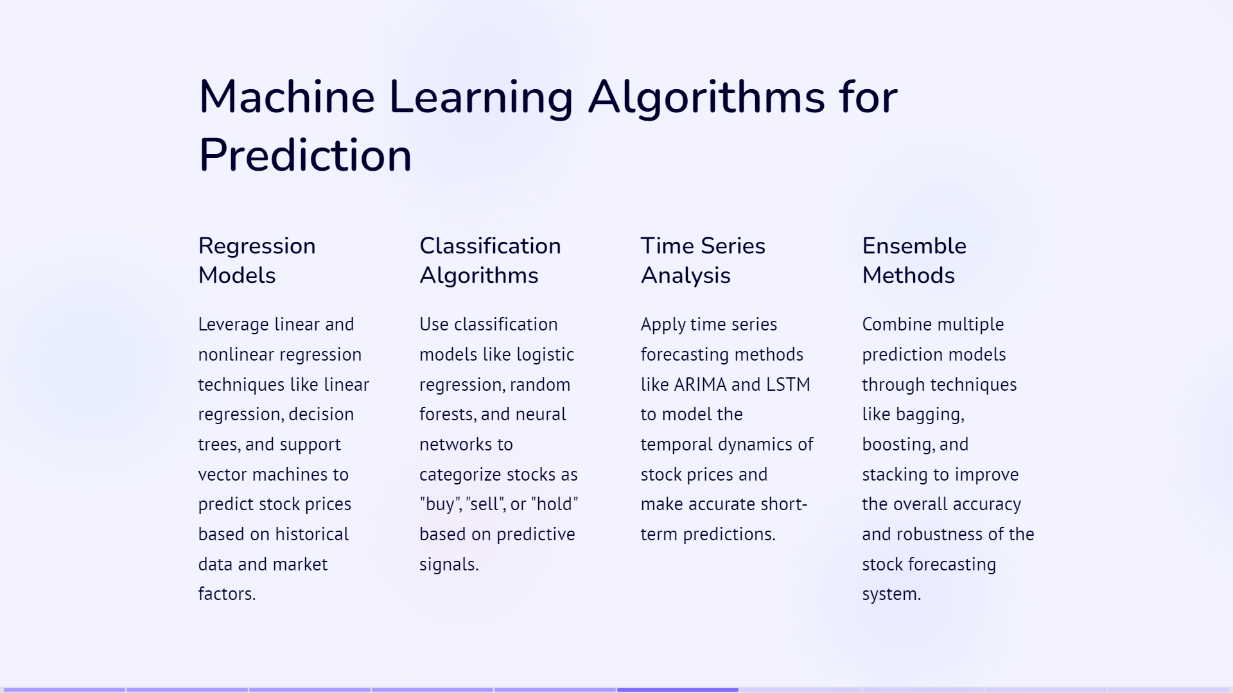

Slide 5
Long short-term memory
Artificial recurrent neural network architecture used in deep learning
Long short-term memory (LSTM) network is a recurrent neural network (RNN).
Aimed at dealing with the vanishing gradient problem present in traditional RNNs.
It aims to provide a short-term memory for RNN that can last thousands of timesteps.
It is applicable to classification, processing and predicting data based on time series, such as in handwriting, speech recognition, machine translation, speech activity detection, robot control, video games, and healthcare.

Slide 6
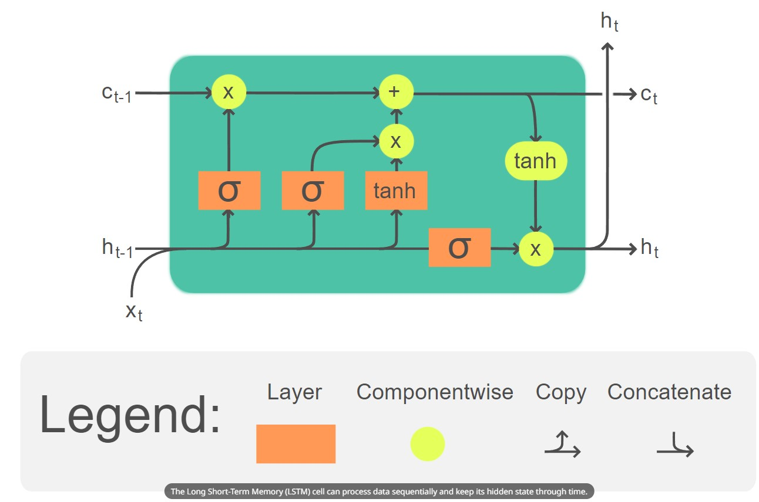
The Long Short-Term Memory (LSTM) cell can process data sequentially and keep its hidden state through time.

Slide 7
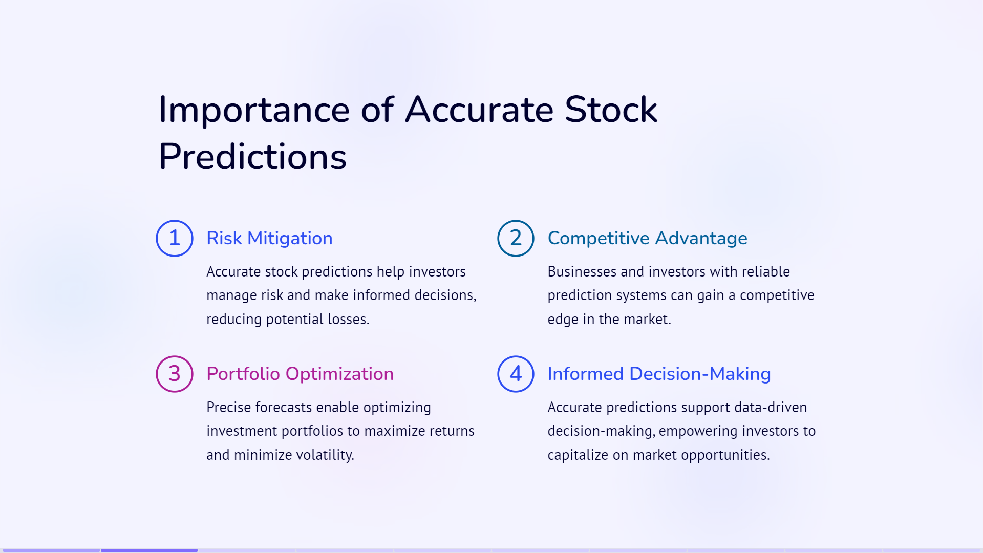

Slide 8
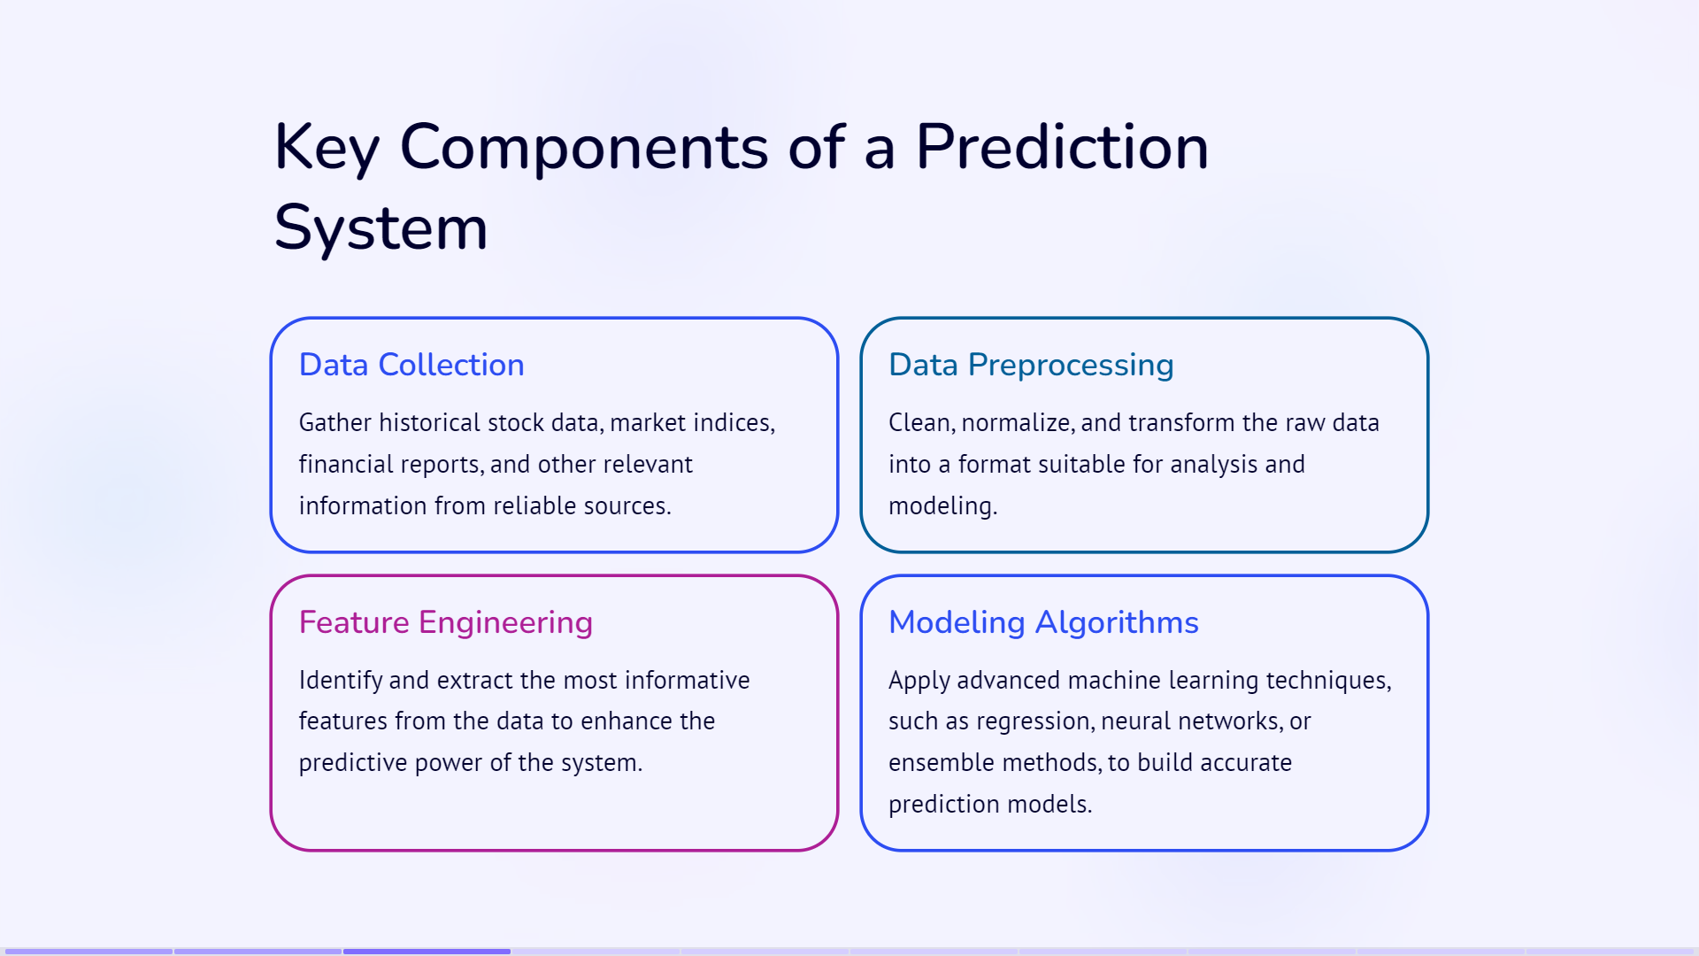

Slide 9
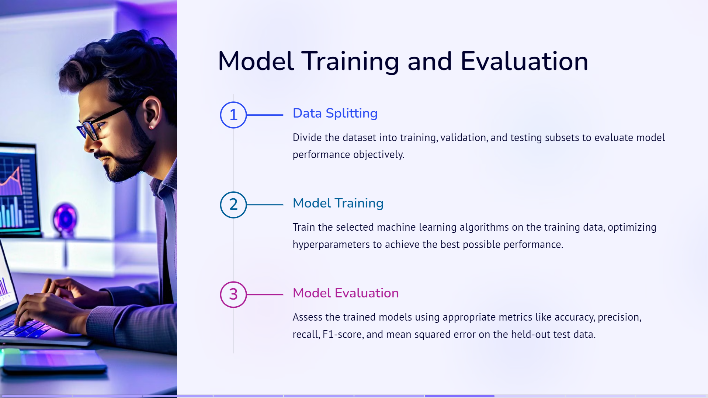

Slide 10
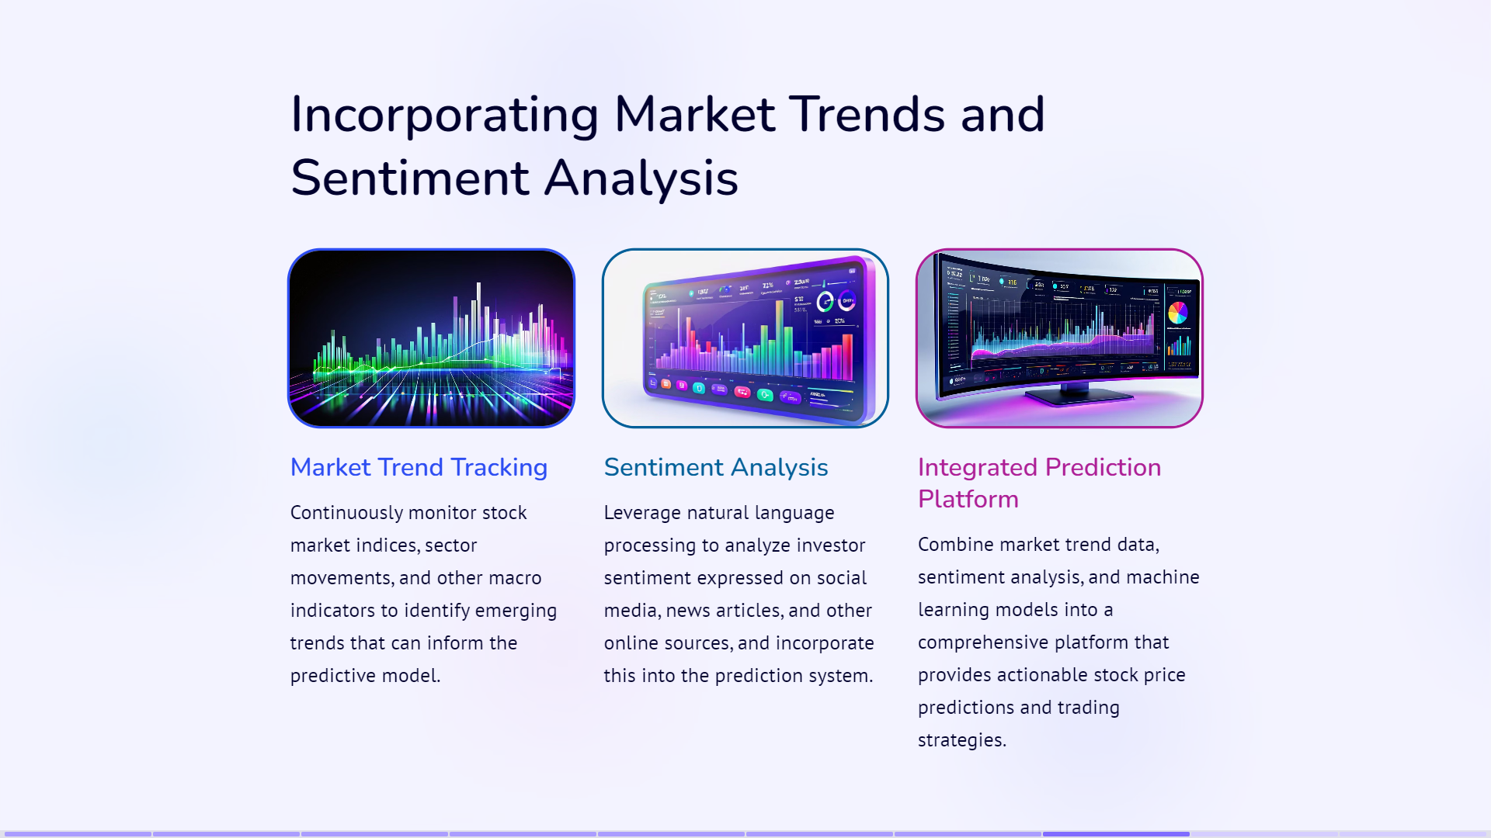

Slide 11
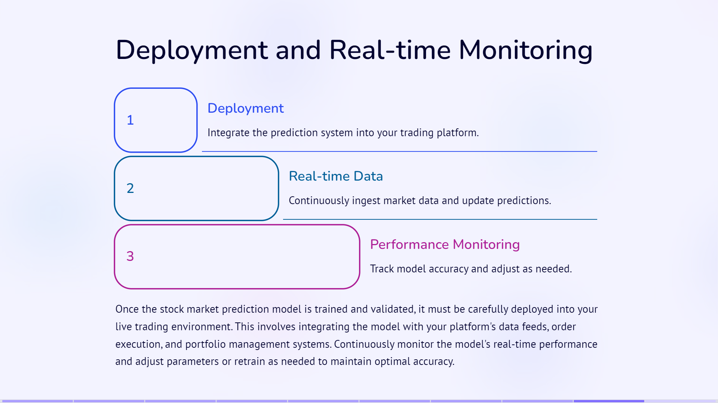

Slide 12
